Slide 1

Introduction of Cryptography
Presented by Prabin Pradhan

Slide 2



1.1 What is Cryptography?
Cryptography is the practice and study of techniques for secure communication, using mathematical algorithms to scramble readable data (plaintext) into unreadable code (ciphertext) so only authorized parties with a key can decrypt it, ensuring confidentiality, integrity, authentication.
Confidentiality
Integrity
Authentication
Keeping information private from unauthorized access.
Ensuring data has not been altered or tampered with.
Verifying the identity of users or systems.

Slide 3
1.2 Encryption:
The process of converting plaintext data into ciphertext with a secret code is known as encryption. A secret key or keys is used for encrypting process.
There are two type of traditional encryption methods.
Symmetric Encryption
Asymmetric Encryption
Symmetric encryption means using single key for encryption and decryption. This method is generally faster but requires secure key exchange.
Asymmetric encryption is also called public key encryption. In this method two keys is used public key for encryption and a private key for decryption.
1.3 Decryption:
The process of converting ciphertext into the original plaintext is known as decryption. A secret key or keys is used to
accomplish decrypting process. It guarantees that data integrity has not been compromised during transmission.

Slide 4
2 Origin and Background:
From ancient civilizations to the digital age, cryptography has evolved to meet the demands of secure communication.
Ancient Age
Middle Age
Early methods like Egyptian hieroglyphs, the Greek scytale, and the Roman Caesar Shift Cipher focused on concealing messages in 1900 B.C.
Arab cryptographers developed frequency analysis around 1000 C.E., revealing weaknesses in monoalphabetic ciphers and start involving a combination of substitution alphabets rather than only one
Modern Age
Cryptography expanded to include authentication and integrity, innovation algorithms like AES, DES, and RSA that form the backbone of today's secure digital systems.

Slide 5
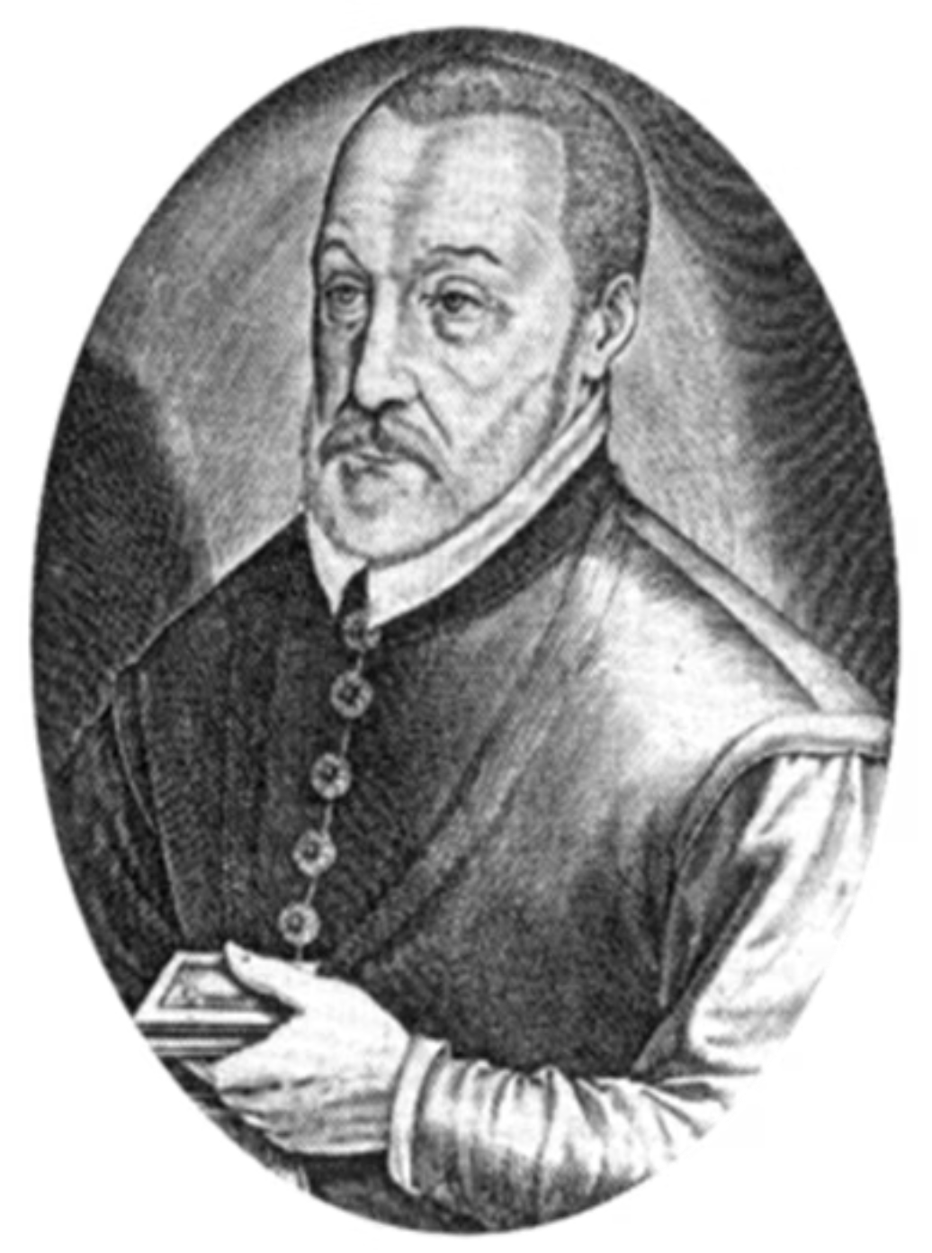
3 Analysis of Specific Cryptography Algorithm
3.1 Vigenere Origin and Background:
Origin: At First Algorithm is described by Giovan Pietro battista Bellaso in his book La Cifra del Sig in 1553.
Vigenere: Later on in the 19th century, the creation of the Bellaso cipher was incorrectly attributed to Vigenere by the court of henry III of France in 1586.

Slide 6
3.2 What is Vigenere Cipher?
Vigenere cipher is a way of encrypting alphabetic texts using a sequence of different Caesar cipher Shifts, each based on the letter of a keyword. Substitution cipher rules based on the shifts of the Caesar cipher that are 0 through 25.
3.3 Traditional Encryption Process Vigenere Algorithm:
Ci = E( Pi + Ki)mod26 (Encryption Formula)
Where Ci is the ciphertext.
Pi is the plaintext character.
Ki is the key.
E is the encryption.
3.4 Traditional Decryption Process Vigenere Algorithm:
Pi = D(Ci − Ki) mod26 (Decryption Formula)
Where Ci is the ciphertext.
Pi is the plaintext character.
Ki is the key.
D is the decryption.

Slide 7
3.5 Weaknesses of the Traditional Vigenère Cipher:
Repeating nature of Keyword.
Vulnerable to Kasiski Examination.
Limited Uppercase Alphabetic Letters.
Short & Predictable Keys.
No uses of Symbol or Special character.
Similar to Caesar Cipher.

Slide 8
4 Developing Phase of Modified Vigenere Cipher:
Use of ASCII Values Alphabets Table.
Adding Symbols, Special character or Numbers in keywords.
Use of XOR Operation.

Slide 9
4.1 Encryption Process of Modified Vigenere Algorithm:
Ci = E(Pi XOR Key) (Encryption Formula)
Ci is Ciphertext.
Pi is the plaintext character.
XOR is Operator.
Ki is the key and E is the encryption.
By introducing ASCII values and the XOR operation, the encryption and decryption processes become more secure.
Plaintext
Keyword
XOR
Decimal
Hexadecimal
C = 01000011
C = 01000011
00000000
0
00
o = 01101111
y = 01111001
00010110
22
16
m = 01101101
b = 01100010
00001111
15
0F

Slide 10
4.2 Decryption Process of Modified Vigenere Algorithm:
Pi = D(Ci XOR Ki) (Decryption Formula)
Pi is the plaintext character.
Ci is Ciphertext
XOR is Operator.
Ki is the key.
D is the Decryption.
Keyword
Ciphertext
XOR
Decimal
Plaintext
C = 01000011
00000000
01000011
67
C
y = 01111001
00010110
01101111
111
o
b = 01100010
00001111
01101101
109
m

Slide 11


5 Evaluation
5.1 Advantages of Modified Vigenere Cipher:
Modified Vigenere algorithm supports alphabets, numbers, symbol and special character.
Modified Vigenere algorithm is based on ASCII values table having 0-to-255 character codes.
Modified Vigenere algorithm also include XOR operation for enhancing security of encryption as well as decryption.
Modified Vigenere algorithm works on increasing randomness number of encrypting ciphertext.
5.2 Disadvantage of Modified Vigenere Cipher:
Modified Vigenere algorithm still done in symmetric key.
Modified Vigenere algorithm is not safer than other algorithm like AES, RSA and SDES.
Modified Vigenere encrypting process is done through ASCII table, maybe its vulnerable to modern cryptanalytic.
Modified Vigenere algorithm still have keywords repetition problem.

Slide 12
End.

